Slide 1
Company-community partnership and climate change adaptation practices
the case of smallholders coffee farmers in Lampung, Indonesia
Ayu Pratiwi (Turku School of Economics)
Guenwoo Lee (Institute of Economics Research, Hitotsubashi University)
Aya Suzuki (The University of Tokyo)

Slide 2
Climate change risks in Indonesia
Population has increased at an average rate of 1.49% during 2000-2010 (Firman 2016)
Poverty alleviation remains a challenge with 10.96% population still living in poverty in 2014 (Indonesia 2015).
Deforestation, forest fires, and degradation of peat land placed the country as the world’s 5th largest emitter of greenhouse gases and the largest contributor of forest-based emission (Wijaya et al. 2017).
Climate change will increase economic vulnerability of the smallholder producers due to significant projected decrease in yields.
About 2 to 3 % more intense rainfall each year; decreased soil fertility by 2 to 8%, declining annual share of rice yields by 4% and maize by 50% (Sari et al. 2007).

Slide 3
Past climate adaptation efforts
“Climate Field School” in Indramayu region in 2003 to promote application of climate forecasts to crop selection decisions, but after 5 years, adoption is virtually non-existent (Siregar and Crane 2011).
  due to perceived risks associated with such practices and lack of understanding of the benefits
In Papua, farmers perceived climate change has little impact to their livelihood due to more apparent important factors such as logging, mining, infrastructure development, and political decentralization (Boissière et al. 2013), which explained why the programs on climate change have little to no effects.
Governments are often fail in pushing climate measures, how about private sectors?
  i.e. Rainforest Alliance and UTZ, and company-community partnership (CCP)
The main purpose for private sectors, particularly multi-national companies (MNCs) to engage in CCP, is to procure commodities directly from the farmers, resulting in more effective supply chains and consequently increased demands of production from their main export markets (Narrod et al. 2009).

Slide 4
Research Questions
What are the determinants of participation in company-community-partnership (CCP) initiated by the private sector?
To what extent this partnership helps the smallholders increase their farm income and climate change adaptation strategy* simultaneously through:
(1) The adoption of resource-conserving agricultural practices
(2) Crop diversification
(3) Forest-tree planting
* Indicated a spillover from the CCP, as primarily CCP focuses on yield production and non-chemical quality (no-pesticide), not necessarily on sustainable practices

Slide 5
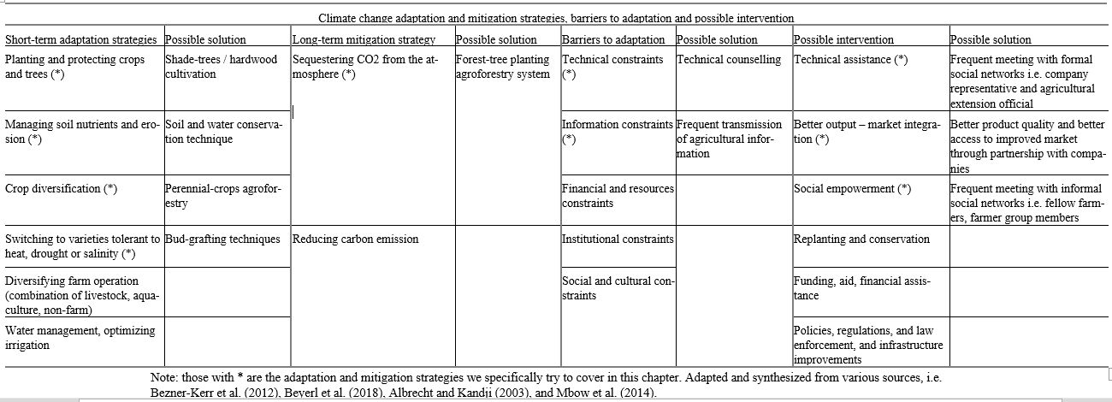
Adaptation and mitigation strategies, barriers to adaptation and possible intervention

Slide 6
Agricultural characteristics in Lampung
Agroforestry
Teak (Tectona grandis), Albasia (Albizia Falcata), Jabon (Anthocephalus cadamba), Banyan (Ficus microcarpa), Rattan (Calamus manan), Bamboo (Bambusoideae).
High valued wood commodity, shade-trees, carbon sequestration
Grafting techniques
More tolerant species via combination of strong rootstocks and improved varieties

Slide 7
Agricultural characteristics in Lampung
Soil and water conservation techniques
Improve porosity of the soil and increase ability to bind water
Intercropping (main coffee cash crops with other category)
Cereal Crops | Legume Crops | Industrial Crops | Spices Crops | Vegetable Crops | Fruit Crops | Hardwood
Rice Corn | Soybean Petai Peanut Almond Dogfruit | Coffee (Arabica) Coffee (Robusta) Tobacco Cocoa Palm Coconut Areca | Chilli Nutmeg Clove | Cabbage Cucumber Eggplant Tomato | Durian Snakefruit Banana Avocado Papaya | Teak Mahogany Albasia Jabon Other wood
* The list includes 99 varieties of crops, but in so far, the above is what we found being planted

Slide 8
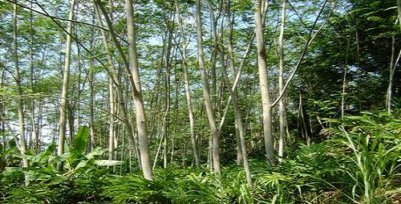
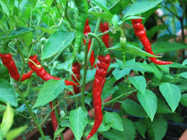
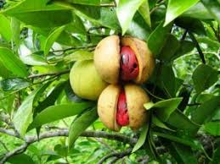
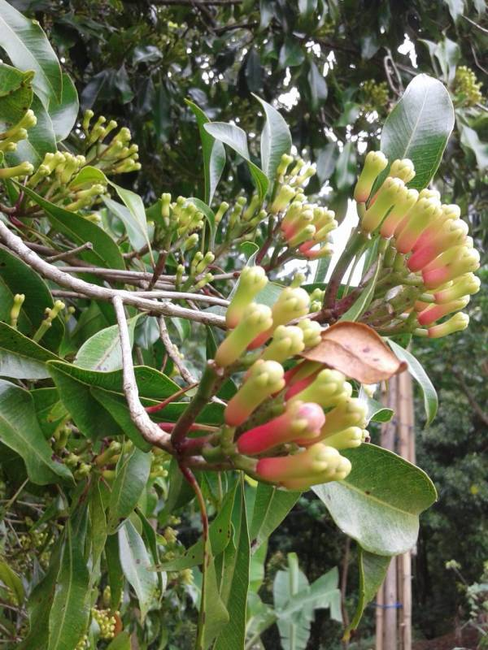
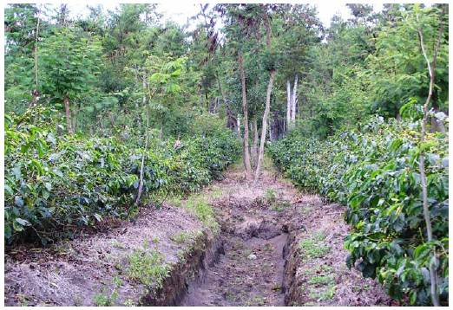
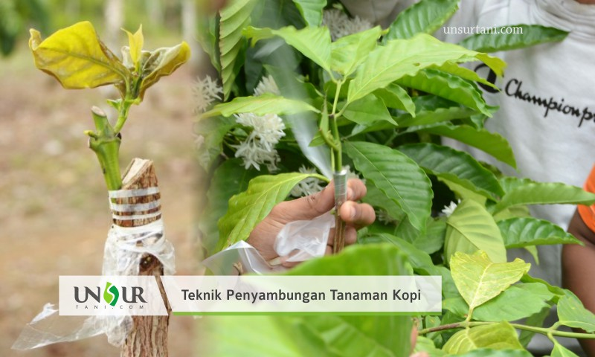

Slide 9
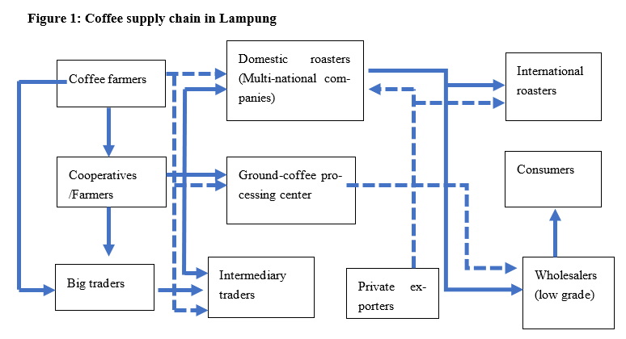
Company-community partnership in Indonesia

Slide 10
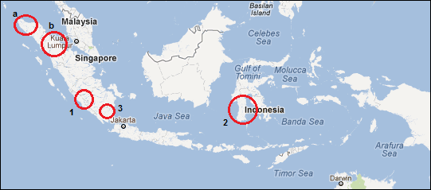
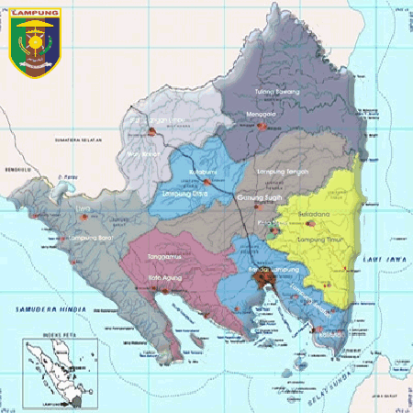
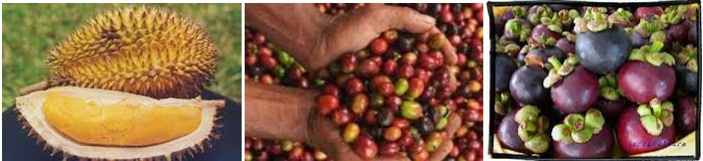
Fieldwork site: Tanggamus district, Lampung
Major coffee and cocoa producer
Total Area: 2,731.61 km²
Population: 548.728 (in 2013)
Density : 200,88 people/km²
Total Farmland: 91.620,64 Ha
Tanggamus district
+/-5km
Household locations
Source: Provincial Government in 2015
9/25/2019
2018 Nordic conference on development economics
10
Notes:
Insert total population, major produce, etc

Slide 11
Methodologies
16 out of 36 randomly selected farmers group based on regional census in 2008 in Sumberejo and Pulau Panggung sub-district in Tanggamus district,
Listed 240 coffee farmers as their members in 2012.
7 groups belong to the company partnership vs 9 non-partnership (partnership starts before baseline)
Data collection spans 3-years period, from September 2012 to 2014.

Slide 12
Summary Statistics
Variables | Partnership |  | Non-Partnership
 | Mean | SD | Mean | SD | p
Years of schooling of most educated person | 10.462 | 2.812 | 10.855 | 2.585 | 0.056
Ratio of males in the household | 0.507 | 0.162 | 0.549 | 0.175 | 0.001
number of household members | 3.856 | 1.166 | 4.072 | 1.367 | 0.027
Second-generation migrant | 0.645 | 0.479 | 0.575 | 0.495 | 0.055
No. of hired labor | 3.651 | 2.709 | 2.962 | 2.453 | 0.004
Owned farmland (ha) | 1.375 | 1.031 | 1.083 | 0.825 | 0.000
Cultivated farmland (ha) | 1.342 | 0.962 | 1.064 | 0.809 | 0.000
Own motorbike (=1 if yes) | 0.917 | 0.276 | 0.831 | 0.376 | 0.000
Own car (=1 if yes) | 0.096 | 0.296 | 0.039 | 0.194 | 0.002
No. of names household seek for farming advice | 5.200 | 2.995 | 4.337 | 2.967 | 0.000
No. of names household seek for farming advice from within group | 3.273 | 2.824 | 2.654 | 2.650 | 0.003
Log of total farm income | 16.466 | 1.137 | 16.017 | 1.144 | 0.000
Adopting grafting (=1 if yes) | 0.945 | 0.228 | 0.872 | 0.334 | 0.001
Adopting conservation techniques (=1 if yes) | 0.873 | 0.334 | 0.825 | 0.380 | 0.079
Planting spice crops (=1 if yes) | 0.708 | 0.455 | 0.611 | 0.488 | 0.006
Planting hardwood (=1 if yes) | 0.190 | 0.393 | 0.128 | 0.334 | 0.022
Observations | 363 |  | 360

Slide 13
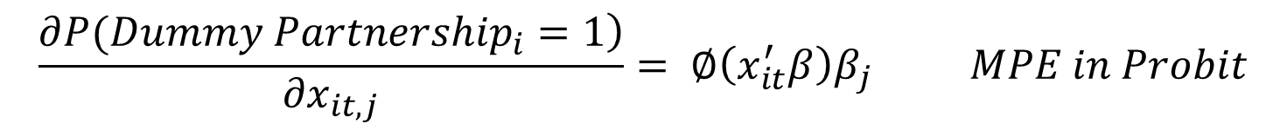
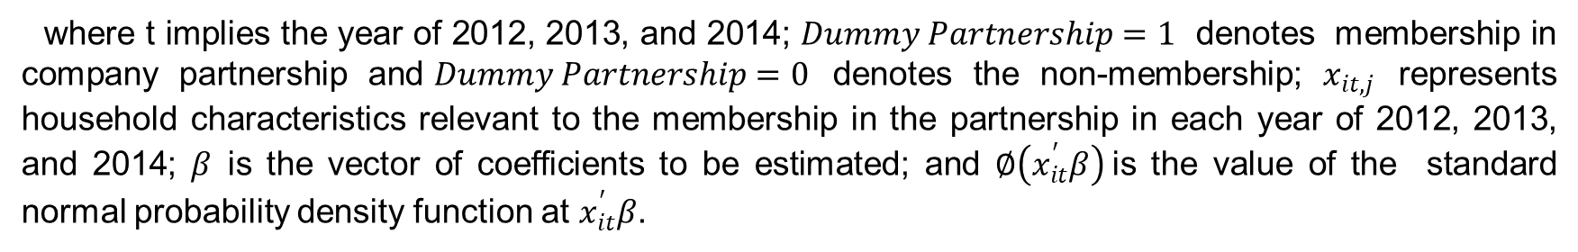
Estimation Strategy: 2 steps
(1) Evaluate the marginal probability effects (MPE) of explanatory variables to be in a partnership with companies based on Probit and Logit models.
$$\frac{\left.∂P({Dummy Partnership}_{i}=1\right)}{∂x_{it,j}}= ∅\left(x_{it}^{′}β\right)β_{j} MPE in Probit$$
$$\frac{\left.∂P({Dummy Partnership}_{i}=1\right)}{∂x_{it,j}}= Λ\left(x_{it}^{′}β\right)(1−Λ\left(x_{it}^{′}β\right))β_{j} MPE in Logit$$
where t implies the year of 2012, 2013, and 2014; $Dummy Partnership=1$ denotes membership in company partnership and$Dummy Partnership=0$ denotes the non-membership; $x_{it,j}$ represents household characteristics relevant to the membership in the partnership in each year of 2012, 2013, and 2014; $β$ is the vector of coefficients to be estimated; and $∅\left(x_{it}^{′}β\right)$is the value of the standard normal probability density function at $x_{it}^{′}β$.

Slide 14
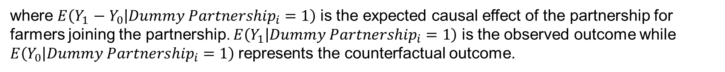
Estimation Strategy: 2 steps
(2) Propensity-score matching (PSM, Kernel matching) and inverse propensity-score weighted regression (IPWR) to reduce the differences that were due to observable characteristics between farmers in partnership and non-partnership.
$$ATT=E\left(Y_{1}−Y_{0} | {Dummy Partnership}_{i}=1\right)=E\left(Y_{1} | {Dummy Partnership}_{i}=1\right)−E\left(Y_{0} | {Dummy Partnership}_{i}=1\right)$$
where $E\left(Y_{1}−Y_{0} | {Dummy Partnership}_{i}=1\right)$ is the expected causal effect of the partnership for farmers joining the partnership. $E\left(Y_{1} | {Dummy Partnership}_{i}=1\right)$ is the observed outcome while $E\left(Y_{0} | {Dummy Partnership}_{i}=1\right)$represents the counterfactual outcome.
For IPWR, the weight is equal to one for observations that are in the partnership, and $px(x)/(1−ps\left(x\right))$ where $px$ is the propensity score for non-partnership observations

Slide 15
Determinants of CCP
 | (1) | (2)
VARIABLES | Probit Marginal effects | Logit Marginal effects
Log of cultivated farmland | 0.077*** | 0.0762***
 | (0.029) | (0.029)
Mobile phone possession (=1 if yes) | -0.111* | -0.112*
 | (0.066) | (0.067)
Motorbike possession (=1 if yes) | 0.159** | 0.160**
 | (0.075) | (0.077)
Car possession (=1 if yes) | 0.162** | 0.165**
 | (0.082) | (0.083)
No. of advice network who are farmers group members | 0.019*** | 0.020***
 | (0.007) | (0.008)
Observations | 655 | 655
Pseudo R-squared | 0.034 | 0.034
F test of joint-significance | 0.002 | 0.003
chi2 | 28.08 | 26.46

Slide 16
ATT using PSM Kernel matching with bootstrapping
Variable | Farm income (in Rupiah) | Log of farm income | Adopting water and soil conservation technique | Adopting grafting technique | Planting spice crops (= 1 if yes) | Planting hardwood trees (=1 if yes)
ATT | 5,490,000** | 0.253*** | 0.048* | 0.060*** | 0.077** | 0.065***
 | (2,200,000) | (0.083) | (0.031) | (0.021) | (0.038) | (0.025)
Observations | 650 | 650 | 650 | 650 | 650 | 650
Bootstrapped standard errors in parentheses, *** p<0.01, ** p<0.05, * p<0.1. Bootstrap analysis was repeated 50 times.

Slide 17
IPWR results
 | (1) | (2) | (3) | (4) | (5)
VARIABLES | Log of Farm Income | Adopting water and soil cons | Adopting grafting | Planting spices crop | Planting hardwood trees
Company partnership (=1 if yes) | 0.271*** | 0.0570* | 0.0673*** | 0.0933** | 0.0639**
 | (0.0800) | (0.0313) | (0.0222) | (0.0385) | (0.0295)
Age of household head | -0.00612 | 0.00311* | 0.000143 | -0.00653** | 0.00242
 | (0.00624) | (0.00175) | (0.00114) | (0.00274) | (0.00240)
Years of education of household head | 0.00158 | 0.00630 | -0.00506* | -0.0145* | 0.00404
 | (0.0176) | (0.00557) | (0.00280) | (0.00764) | (0.00712)
Log of cultivated farm | 0.873*** | -0.0255 | 0.0328* | 0.147*** | -0.00893
 | (0.0908) | (0.0281) | (0.0186) | (0.0384) | (0.0334)
Mobile phone possession (=1 if yes) | -0.387** | 0.169** | 0.0720 | 0.0483 | -0.0124
 | (0.183) | (0.0720) | (0.0520) | (0.0878) | (0.0709)
Motorbike possession (=1 if yes) | 0.268 | -0.105*** | -0.0617** | -0.212** | -0.0779
 | (0.180) | (0.0398) | (0.0266) | (0.0952) | (0.0966)
Car possession (=1 if yes) | 0.441** | 0.0113 | 0.0277** | 0.166** | -0.0898
 | (0.178) | (0.0602) | (0.0140) | (0.0707) | (0.0683)
No. of advice network in farmers group | 0.0590*** | -0.00408 | 0.00342 | 0.0103 | 0.00271
 | (0.0142) | (0.00750) | (0.00271) | (0.00793) | (0.00752)
No. of advice network outside farmers group | 0.0765*** | 0.00331 | 0.0134** | 0.0156 | 0.00678
 | (0.0282) | (0.0107) | (0.00522) | (0.0129) | (0.0124)
Years of experience in coffee farming | 0.00253 | 0.00205 | -0.000193 | 0.00502** | -0.00462**
 | (0.00490) | (0.00152) | (0.000918) | (0.00213) | (0.00187)
Observations | 618 | 646 | 655 | 655 | 655

Slide 18
Discussion and policy recommendation
well-connected farmers with better access for mobility have higher propensity to join CCP
CCP managed to increase the adaptive capacity of their smallholder clienteles through two channels:
  improved farm incomes resulted from premium coffee selling-prices
  through the usage of resource-conserving agricultural techniques and crop diversification practices as short-term adaptation; and forest-tree planting as long-term mitigation strategies
These practices are not required by CCP, so CCP farmers in partnership may obtain the information somewhere i.e. informal interactions with traders and CCP rep, and extension officials

Slide 19
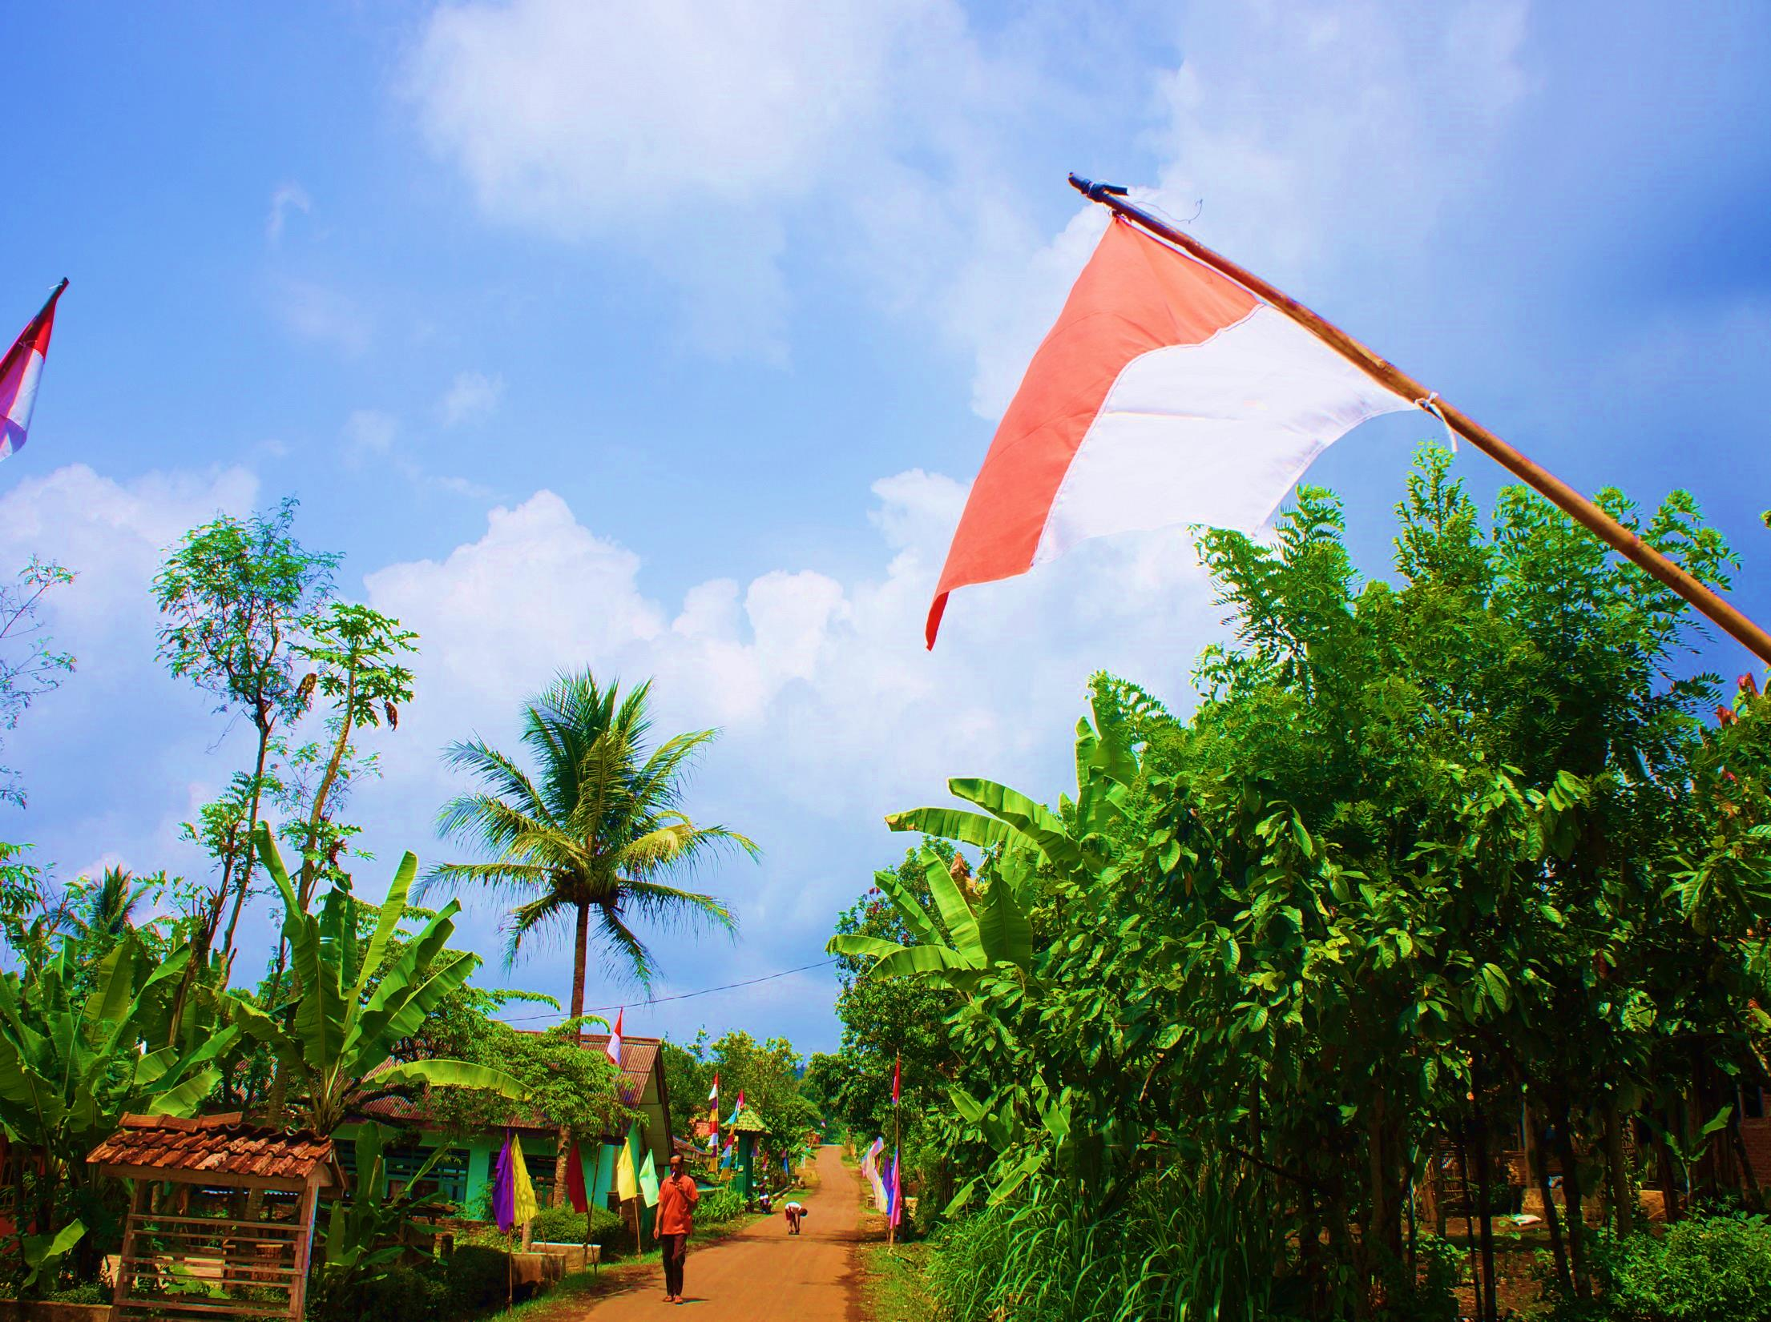
Q&A?

Slide 20
Thank you
Comments and suggestions? Ayu.pratiwi@utu.fi

