Slide 1

Mom bloggers as self-enterprising individuals: Exploring ‘new’ forms of fragile identity work being carried out across the Finnish blogosphere
WORK –conference
14-16 August 2019, Helsinki, Finland
Suvi Satama (stsata@utu.fi)
and Astrid Huopalainen (ahuopala@abo.fi)

Slide 2
The idea of our paper
This paper delves into the communicative practices of mom blogging as a multiple and intriguing site for (gendered) identity work.
Here, we ask how digital technologies, dominant expectations and normative idea(l)s relating to both (self-)entrepreneurship and motherhood come to shape, discipline and construct contemporary maternal entrepreneurial subjectivities.

Slide 3
Research questions
How do mom bloggers negotiate their multiple identities – as mothers, entrepreneurs and consumers on their blogs?
What kind of tensions or contradictions related to motherhood and self-entrepreneurship do the bloggers write about in the context of ‘new’ and emerging digital work, and how are these matters dealt with or communicated on the blog?

Slide 4
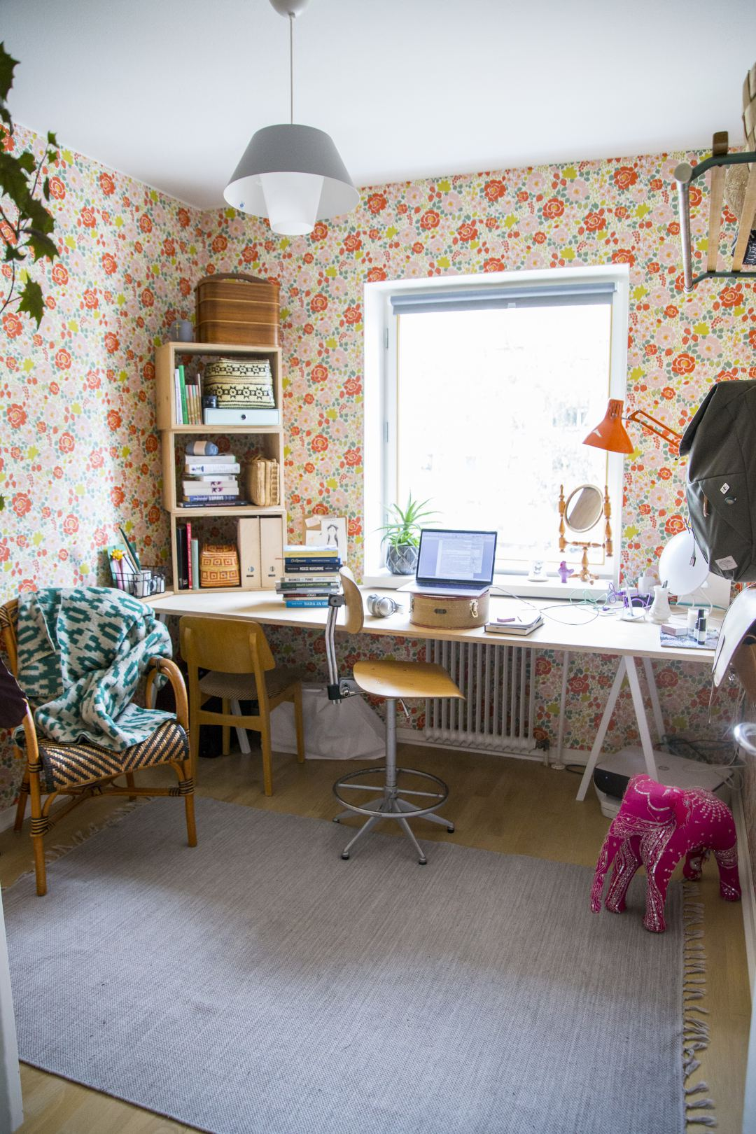
https://polarnopyret https://www.google.fi/url?sa=i&rct=j&q=&esrc=s&source=images&cd=&ved=0ahUKEwi4qqKCh-jUAhVIKFAKHZ8VBwYQjRwIBw&url=https%3A%2F%2Fwww.pinterest.com%2Fexplore%2Fkids-fashion%2F&psig=AFQjCNHoqyfuLFObj0nKvxQf7nDSB8LEAg&ust=1498997508160096.fi/media/wp-content/uploads/2016/06/Filosofiamme-pysty.jpg https://polarnopyret.fi/media/wp-content/uploads/2016/06/Filosofiamme-pysty.jpg

Slide 5
Theoretical concepts of the paper
Digital labour, blogging
Mumpreneurship
Identity work

Slide 6
“To us, identities are fragmented, temporary, collective and evolving constructions and identity work requires an individual’s constant effort in crafting and maintaining identity.”

Slide 7
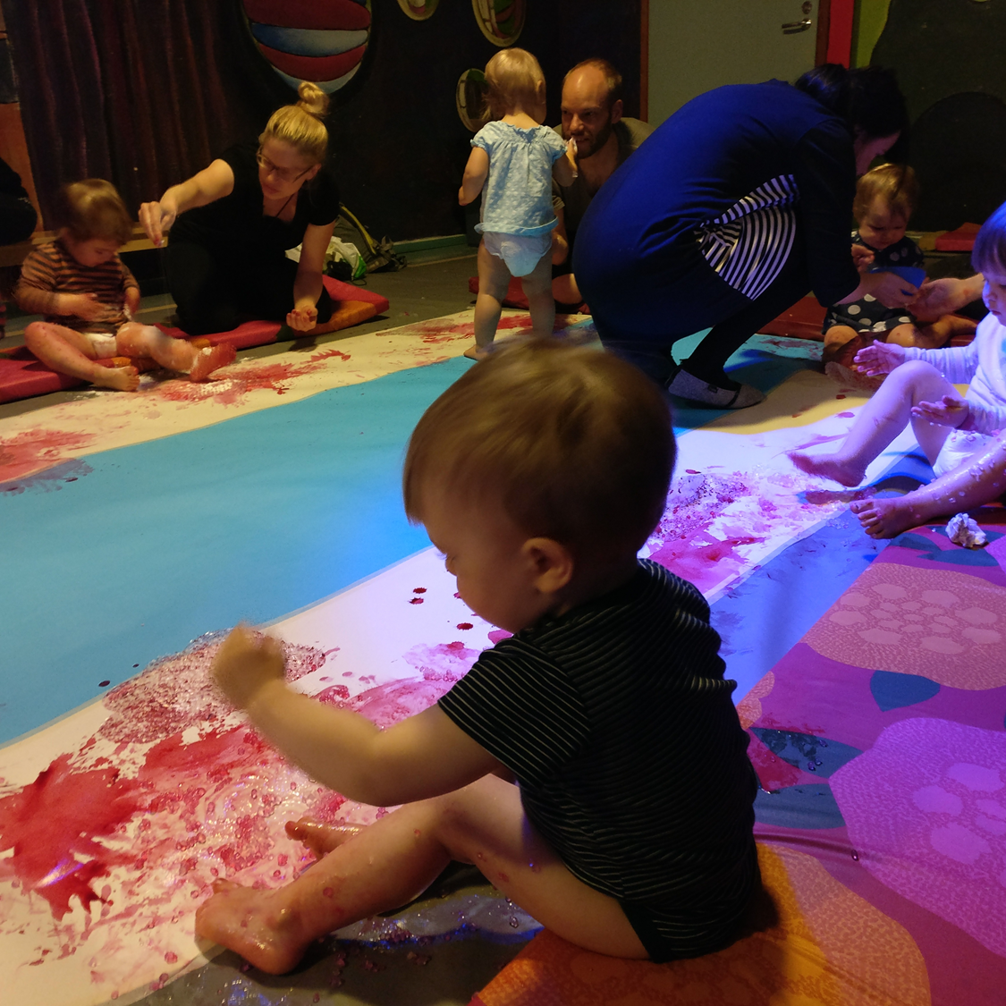
Methodology
Netnography as our research approach
Reflexive, collaborative analysis of netnographic material
Blogs as research material
For us, doing research is an ’embodied process’

Slide 8




https://polarnopyret https://www.google.fi/url?sa=i&rct=j&q=&esrc=s&source=images&cd=&ved=0ahUKEwi4qqKCh-jUAhVIKFAKHZ8VBwYQjRwIBw&url=https%3A%2F%2Fwww.pinterest.com%2Fexplore%2Fkids-fashion%2F&psig=AFQjCNHoqyfuLFObj0nKvxQf7nDSB8LEAg&ust=1498997508160096.fi/media/wp-content/uploads/2016/06/Filosofiamme-pysty.jpg https://polarnopyret.fi/media/wp-content/uploads/2016/06/Filosofiamme-pysty.jpg

Slide 9
Preliminary findings
By now, we have formed two dimensions that we recognized by reading the blogs. These are:
  Blogging as exhausting self-entrepreneurial identity work
    Blogging is easily viewed as an unintellectual, disturbingly commercial or unreal sphere. Here, we discuss how the studied Finnish mom bloggers all seemed to construct devalued and ‘frivolous’ blogging as sometimes exhausting, effortful and ‘real’ work, thus deliberately challenging the shallow image attached to their work.
    ”When I work, I close out everything else around me. If all three children are around, working is impossible. I work whenever it’s possible. Of course, I sometimes feel the urge to relax and take it easy, but it is not possible when my ‘me-time’ is the only time available for work.”

Slide 10
Preliminary findings
  Blogging as an intimate and embodied identity work
    Problematizing hegemonic understandings of motherhood through radically personal and intimate blog posts
“The ones I collaborate with (most of them I critically skip) in my blogs are the ones that fit into myself.”
“Becoming a mother has changed me a lot. I didn’t choose my motherhood consciously – things just led to another. But it was not before becoming a mother when I found a large part of myself.”

Slide 11
Conclusion
We contribute to the discussion on blogging as relatively ‘new’ and gendered form of digidentity work by bringing together the perhaps controversial –embodied and virtual – as well as public and intimately private life-worlds.
The increasing blurring of work/leisure in an era of 24/7 capitalism calls for in-depth empirical studies investigating blogging as work.
Exploring bloggers’ identity work helps to gain more nuanced, context-specific and dynamic perspective of mumpreneurs, bridging between individual perceptions and broader surrounding societal factors that influence their identity work.

Slide 12
Questions for you
What to focus on especially? In fact, what are we trying to claim?
How to take gender into discussion in this paper?
How to make the paper more so that it wouldn’t be so marginal and would touch on a wide range of organizational scholars?
Do you have experiences of blogs as research material and, if yes, what kind of tips would you like to give us?

Slide 13
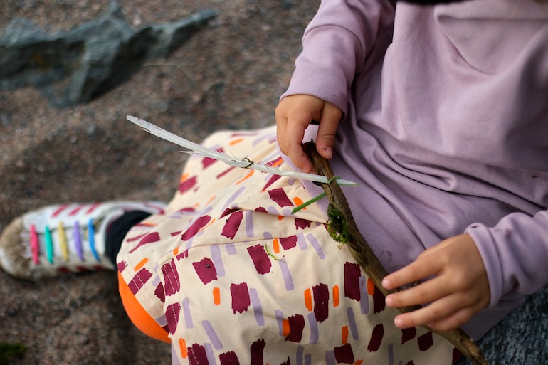
Questions – comments?
Thank you!

